Slide 1
OVERVEIW OF AFGHANISTAN
Abdul Matin
138682E
Mohammad Zubair
138684B
2013.11.01

Slide 2
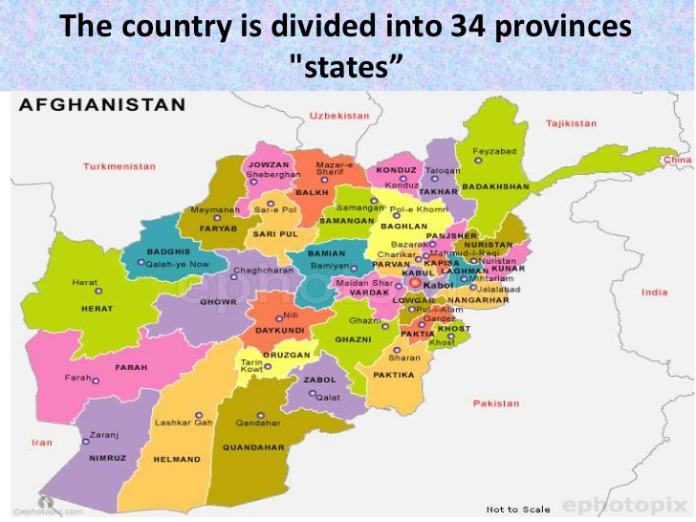
Geographical information
Area: 647,500 km² (250,001 sq. mi)
Location: 33.9333° N, 66.1833° E
Kabul is the capital of Afghanistan
Population: around 30 million
the 42nd most populous and 41st largest nation in the world

Slide 3
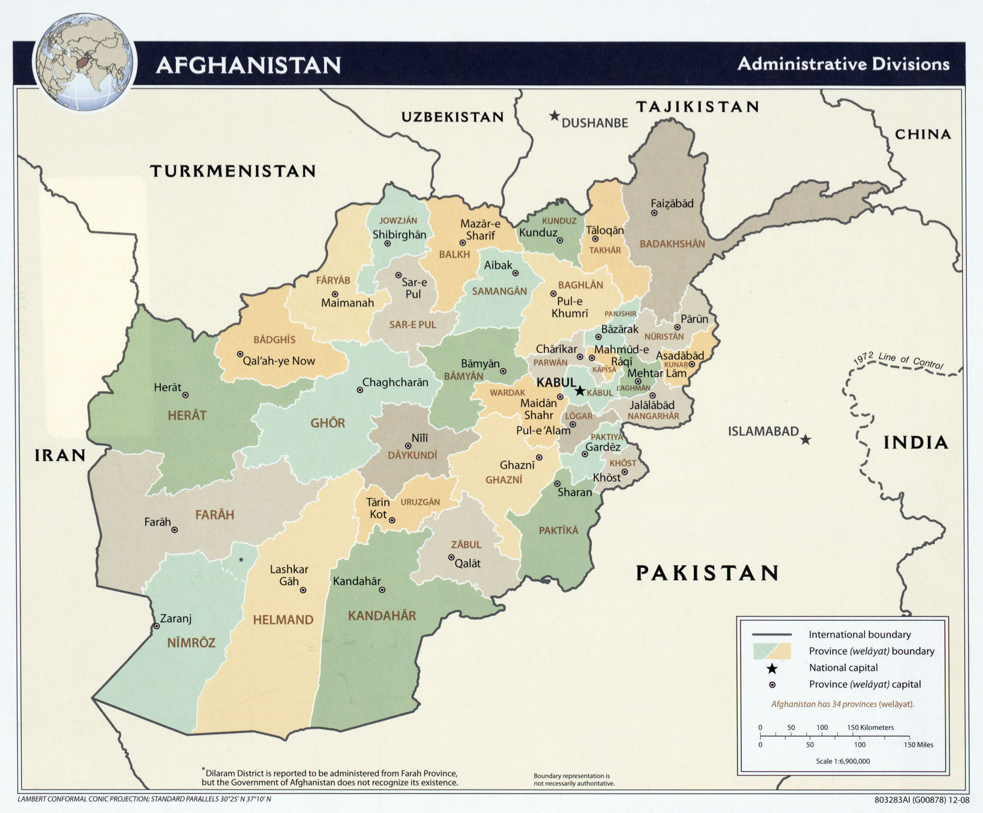
Count.
The total length of Afghanistan border is 5529km. The border with, Pakistan 2430 km, Tajikistan 1206Km, Iran 936km, Turkmenistan 744km, Uzbekistan border 137 km, and China 76km.

Slide 4
Climate
Afghanistan has for seasons: spring, summer, fall and winter
Weather: hot summer and cold winter , dry weather
average rainfall: 25 cm to 30cm

Slide 5
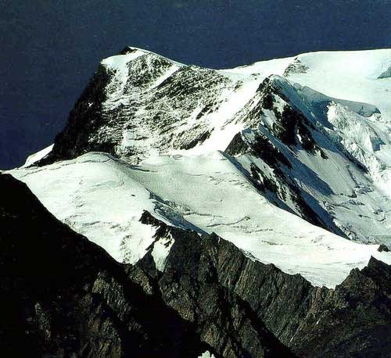
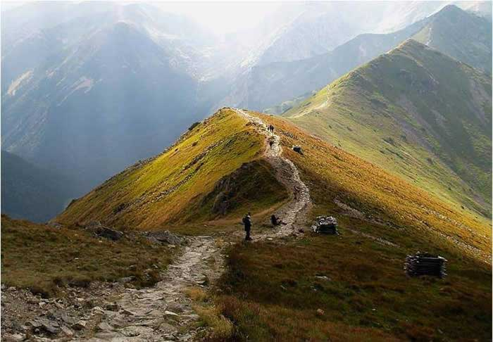
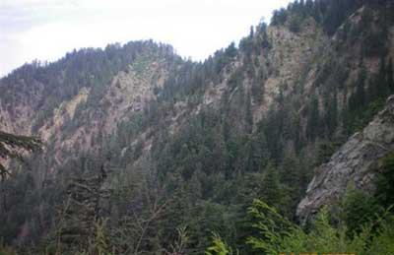
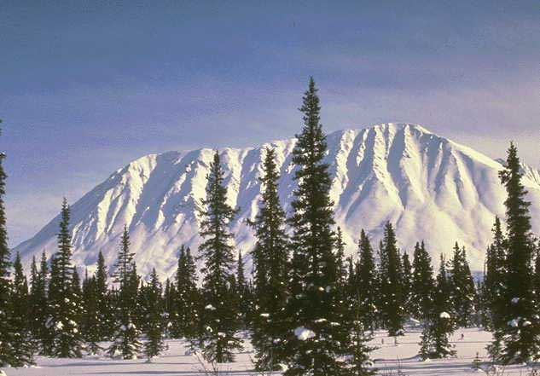
Mountains and Rivers
Hindu Kush: from NE to center 600 Km, peak 7485 m (Nowshakh)
Koh Baba: about 200Km, 5140 m peak (Shahfoladi)
Spenghar: about 150Km with 4755 m peak (Sikaram)

Slide 6
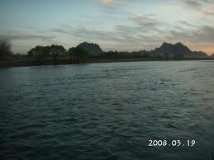
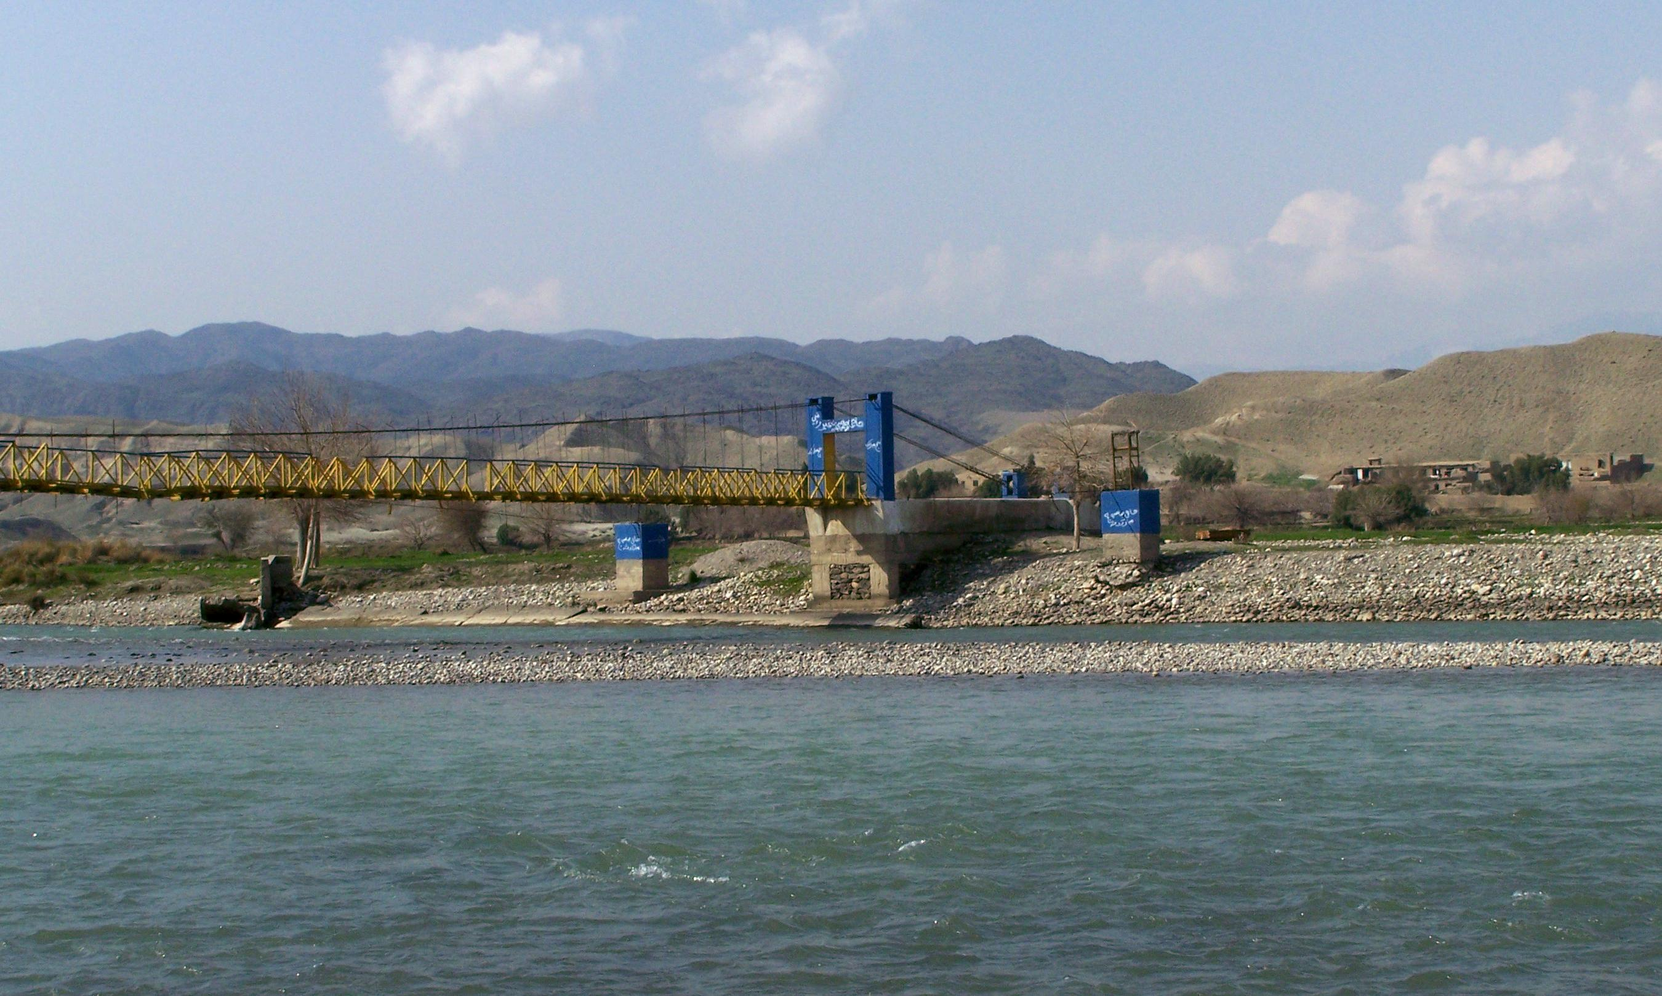
Rivers
Amu darya: springhead Pamir, 1126Km borders
Harirud: : springhead Kohebaba, 1230Km
Kabul River: passes central and east part
Helman River: : springhead Paghaman mountains, 1400Km toward Iran border

Slide 7
Health
Afghanistan is the 15th least developed country in the world
Average life: around 60 years, both male and female
Maternal mortality rate: 460 deaths/100,000 live births (2010)
Infant mortality rate: 119.41 deaths/1,000 live births (2012)
Access: 57% of Afghans say they have good or very good access to clinics or hospitals

Slide 8
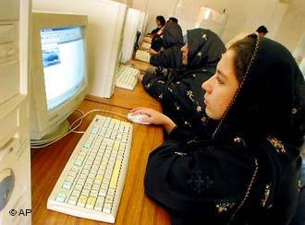
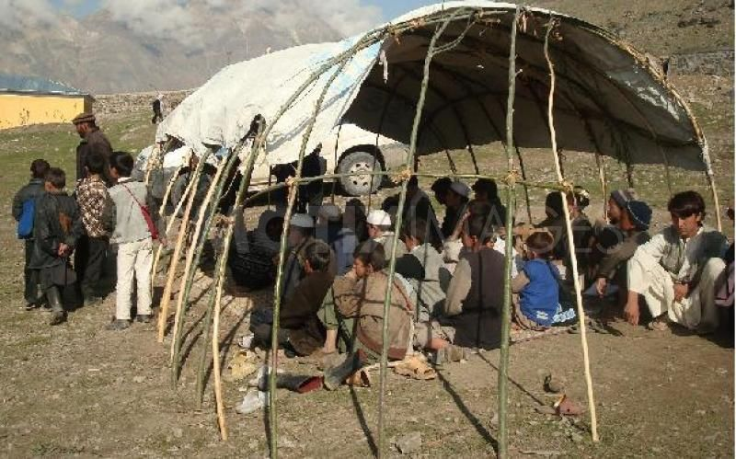
Education
School system is 12 grad
There are around 7 million student, 37% are female
In 12000 general schools
There are 26# governmental and 52# private higher educations institution
Currently around 140,000 students

Slide 9
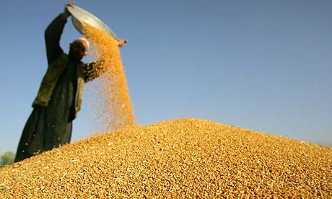
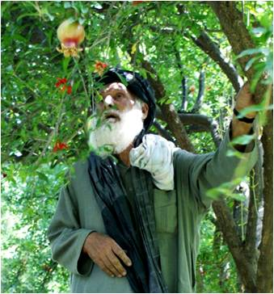
Agriculture
Agriculture sector in Afghanistan contributed 28% to the Gross Domestic Product (GDP)
most of the rural people are busy with agriculture
Agriculture product: Grain: wheat, rise, corn
Fruit: Pomegranate, grips, apple

Slide 10
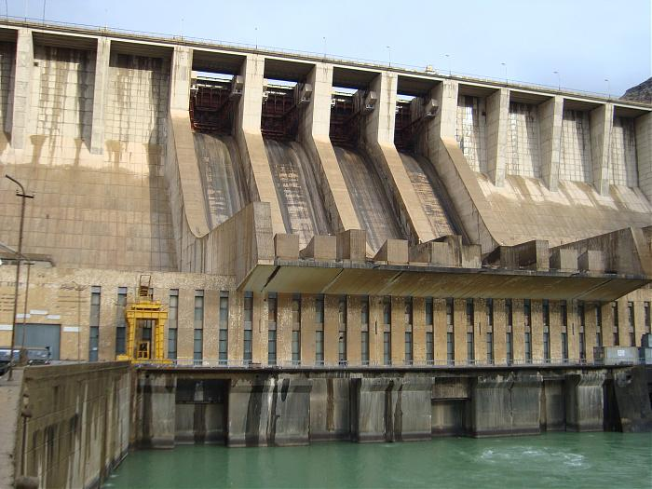
Energy
Electricity: 33% of population has access to electricity,
Natural gas: estimated 140 billion cubic meters. The Production started in 1967.
Oil: reported to have oil reserves 2.9 billion barrels.

Slide 11
از توجه شما تشکر

